Slide 1

Cyber Security
Workshop
SCHOOL OF COMPUTER SCIENCE & ENGINEERING

Slide 2
TIME | SCHEDULE
0925 – 0930 | Join Zoom Call
0930 – 0935 | Administrative Matters
0935 – 1000 | Lecture on Cyber Security Lecture on Information Security
1000 – 1100 | Social Engineering Attack Hands-On (Break-Out Rooms)
1100 – 1130 | Break
1130 – 1145 | Lecture on Network Security (Firewall)
1145 – 1245 | Spoofing of Network Addresses Hands-On (Break-Out Rooms)
1245-1325 | Lecture on Network Security (VPN & SSL) Lecture on Wireless Security
1325-1330 | Survey + Q&A
Schedule
Notes:
15mins + 15mins + 15mins + 25 mins
60mins + 60 mins

Slide 3
What is Cyber Security?
All you need to know before starting

Slide 4

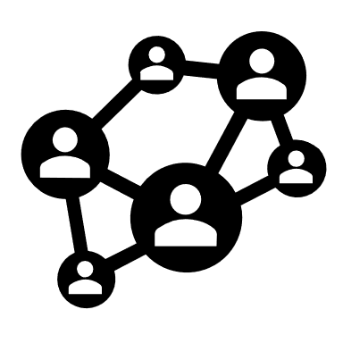




Cyberspace
Interdependent network of information technology infrastructures which includes:
Also referred to the virtual environment of information and interactions between people
Telecommunications Networks
Internet
Computer
Systems
Embedded processers
and controllers

Slide 5








Cyberspace
Most people cannot value security without first understanding how much is at risk
More applications are moving onto the cyberspace
2019
1980

Slide 6


Cyberattack
Attempt by hackers to damage a computer network or system
Deliberate exploitation of vulnerabilities in computer systems, technology-dependent enterprises and networks
Mainly uses malicious code to alter computer code, logic or data
Disruptive consequences that can compromise data and lead to cybercrimes, such as information and identity theft

Slide 7
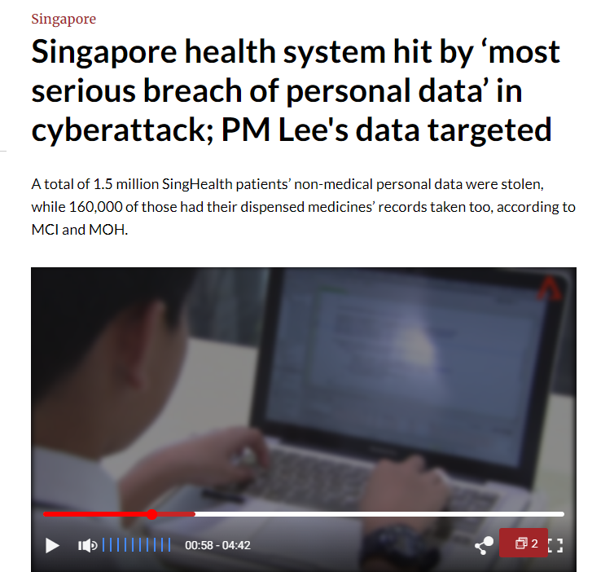
SingHealth
Cyberattack
Notes:
Brief
A software and human error.
Vulnerabilities, weaknesses, and misconfiguration in SingHealth's network, data and Management Application.
Staff lacked adequate levels of cybersecurity awareness, training, and resources to understand the implications of the attack and respond effectively.
While its IT administrators were able to identify suspicious attempts to log into the database, the same staff failed to correlate these findings with the tactics and procedures of an advanced cyberattack.
<A01.html>

Slide 8
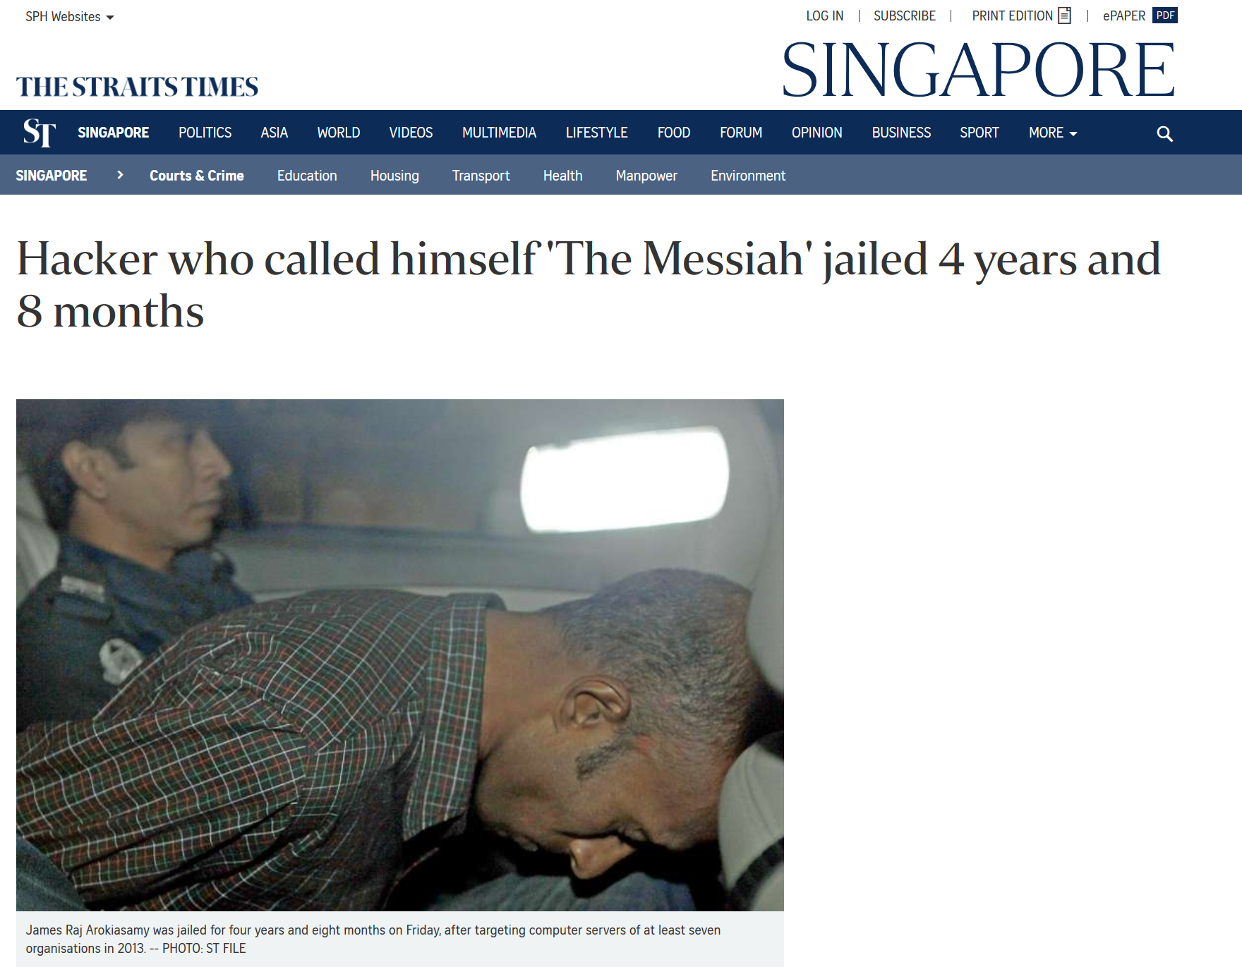
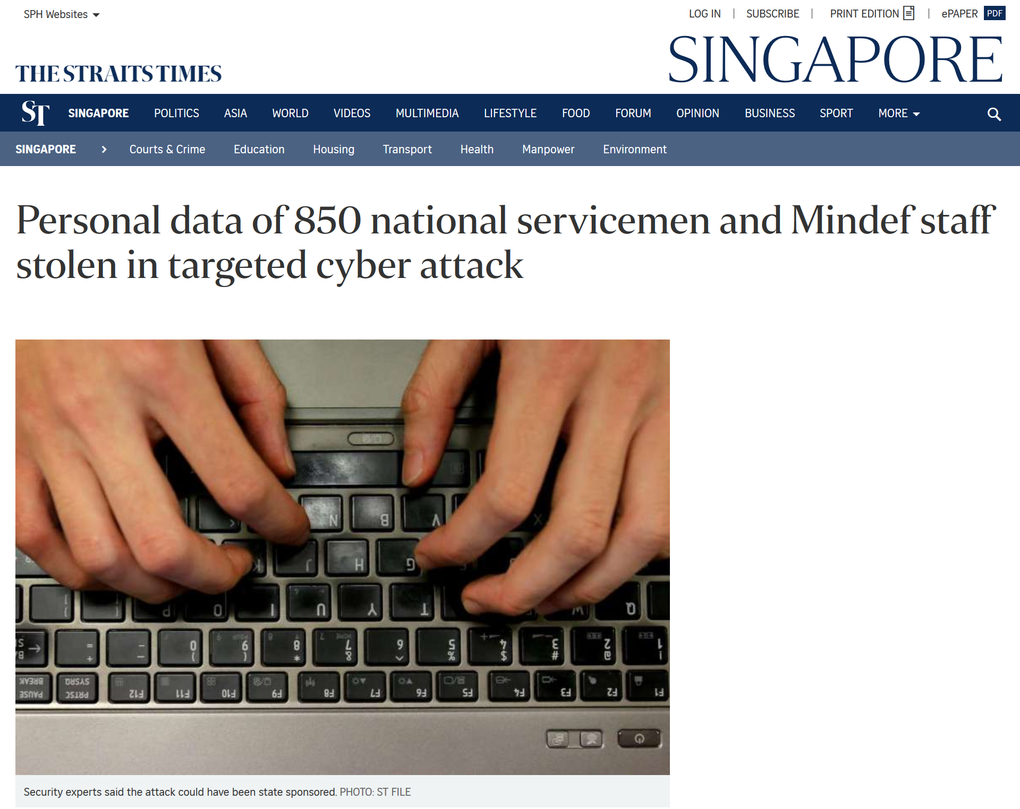
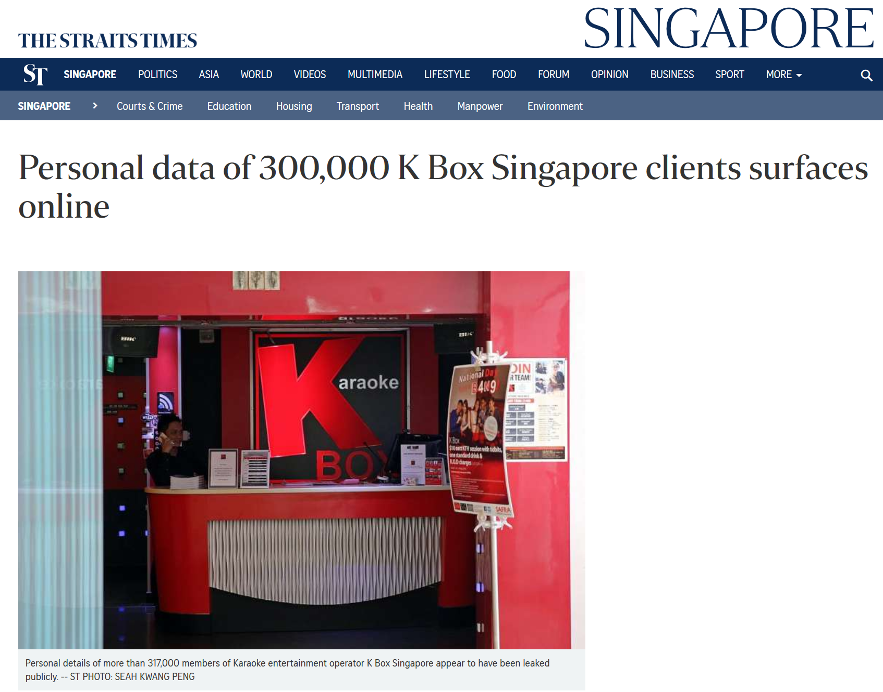
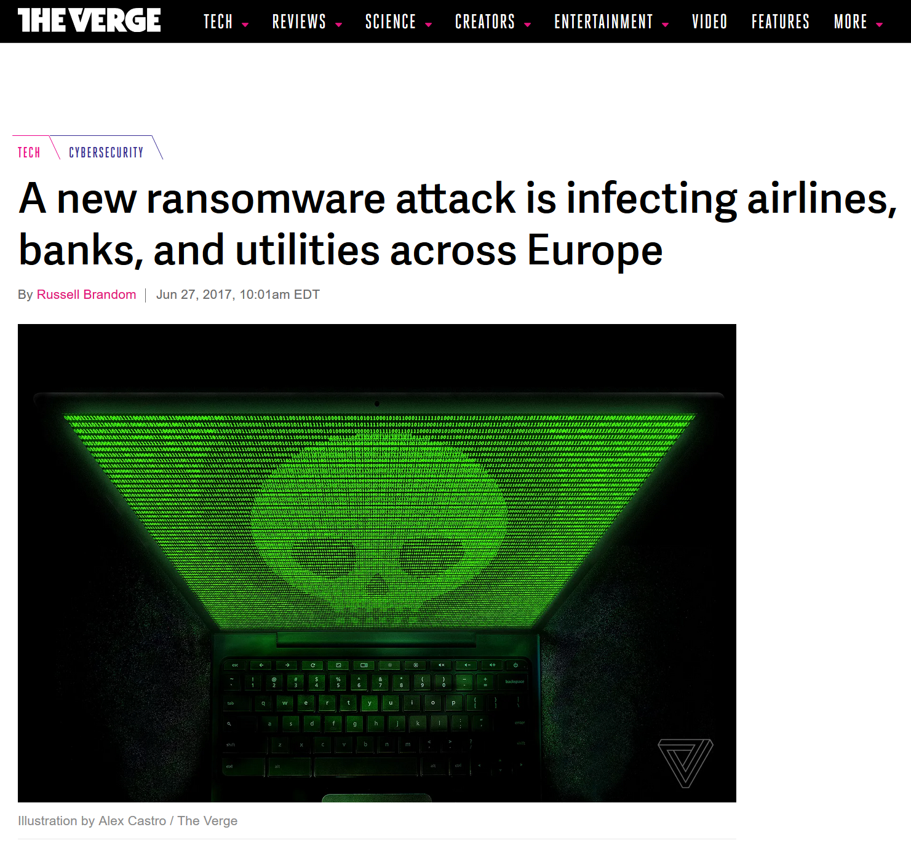
Other
Major
Cyberattacks
Notes:
Briefs
The Messiah: 2013 Singapore Cyber Attacks (October – December 2013)
Defaced with taunts and threats on websites such as PAP Community Foundation, AMK Town Council, City Harvest Church
<A02.html>
MINDEF Cyber Breach (February 2017)
I-Net breached resulted in 850 army personnel’s NRIC, contact numbers and birth dates leaked
Attack done remotely over internet
<A03.html>
K Box Data Breach (September 2014)
Personal data of their customers were leaked (Identity card numbers, mailing addresses, contact numbers)
Weak password to access company system
Customer’s data sent over plaintext using Gmail from its IT Vendor
Malware were found on their Content Management System
<A04.html>
Petya Ransomware (June 2017)
<A05.html>

Slide 9
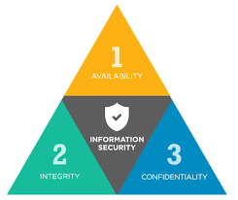
Cyber Security
Definition: Information security in the cyberspace
Must satisfy 3 properties known as the C-I-A Triad
Information/Data is there when you need it
Information/Data you can accessed is correct and not modified by unauthorized parties
Information/Data is only accessible to authorized parties

Slide 10
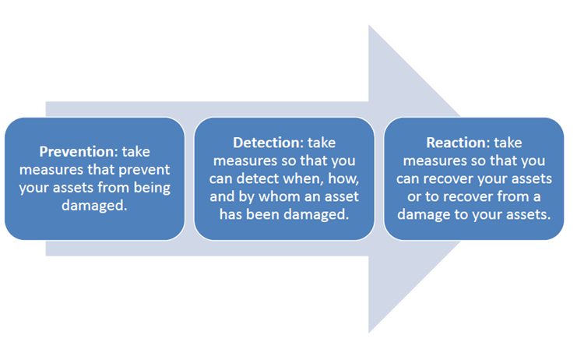
Cyber Security
Security strategies: Prevention, Detection, Reaction, Recover

Slide 11
Cyber Security
Physical Example
Prevention
Detection
Reaction
Locking of doors and window bars
Walls round the property
Missing items
Burglar Alarms
CCTV
Call the police
Replace stolen items
Insurance claim

Slide 12
Cyber Security
Cyber Example
Prevention
Detection
Reaction
Encryption
Two-Factor Authentication (2FA)
Unauthorized transaction on credit card statement
Complain
Request for a new card number

Slide 13


Hacking
Act of finding the possible entry points that exist in a computer system or a computer network and finally entering them (A form of cyberattack)
Ethical Hacking: Used to find weaknesses in a computer or network system for testing purpose

Slide 14
What’s Covered So Far…
Cyberspace
Cyberattacks
Definition of Cyber Security
Definition of Hacking

Slide 15
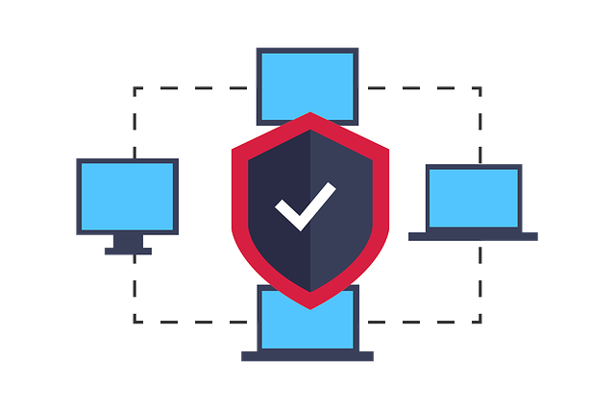
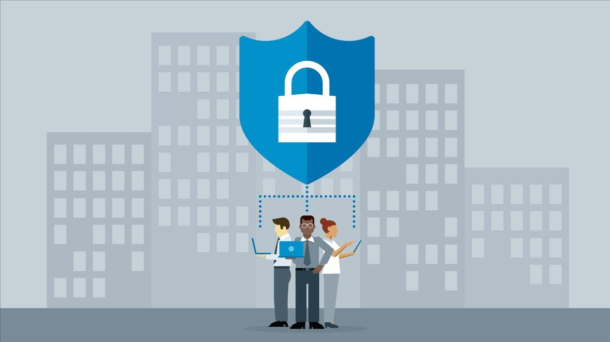
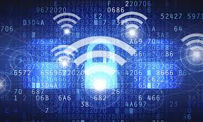
Today’s Focus
Information Security
Network Security
Wireless Security

Slide 16
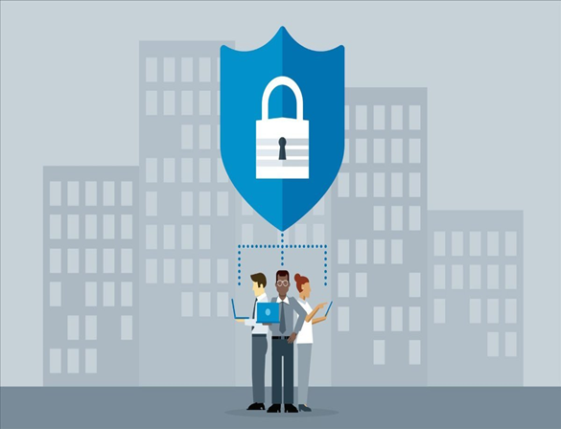
Information Security

Slide 17
Information Security
Information Security is an area of study to protect Information and related resources from unauthorized access, use, disruption, modification or destruction
Includes how to protect the information and all other resources associated with the system from being exploited

Slide 18
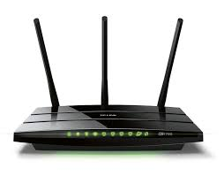
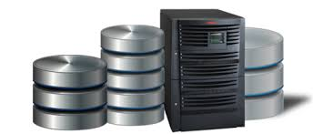
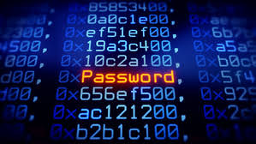
Protect what?
Data – Heart of the matter
  Data make up information
Resources – Every entity that dealt with the Data
  Resources - Entities that interact with one another within the information space to enable the information solution to accomplish its purpose
Network Router
Database Server
User’s Credential

Slide 19




Goals of
Information Security
Prevention
Unauthorized disclosure
Unauthorized modification
Unauthorized withholding of information or resource
Detection
Aware of when, how and by whom an asset has been damaged
Reaction
Implement necessary measures to prevent future attacks
Recovery
Recover assets
Recover from a damage to assets

Slide 20
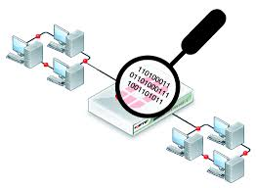
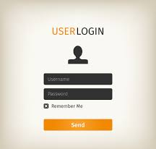
Intrusions vs Attacks
Occurs when an attacker accesses your private space without authorization or permission
Examples:
  Sniffing data packet from a private network
Login a website without legitimate User ID and password

Slide 21
Intrusions vs Attacks
An attack is an action/event to exploit a vulnerability in any entities associated with information system using some techniques
Passive Attacks – No damages caused
  Sniffing wireless traffic data to determine the presence of Wireless APs, i.e. War-Driving
Active Attacks – Caused some forms of damages
  Use DoS (Denial of Service) attack to disallow a WiFi AP to service a mobile phone user

Slide 22
Phishing Attack
Fraudulent attempt to obtain sensitive information or data, such as usernames, passwords, credit card numbers, or other sensitive details by impersonating oneself as a trustworthy entity
  Phishing Emails/Spam Emails
Social Engineering is a kind of attack targeting human behavior by manipulating and playing with their trust, with the aim to gain confidential information, such as banking account, social media, email, even access to target computer
Does not involve breaking into a system directly, instead it is using human social interaction and the attacker is dealing with the victim directly

Slide 23
Phishing Attack
Scenario
Most people uses Gmail; hence the scenario would be to use Social Engineering Attack to gain email access to a person Gmail account
First, we are going to setup phishing Gmail Account login page in Kali Linux, and trigger it by browsing to that page on another machine

Slide 24
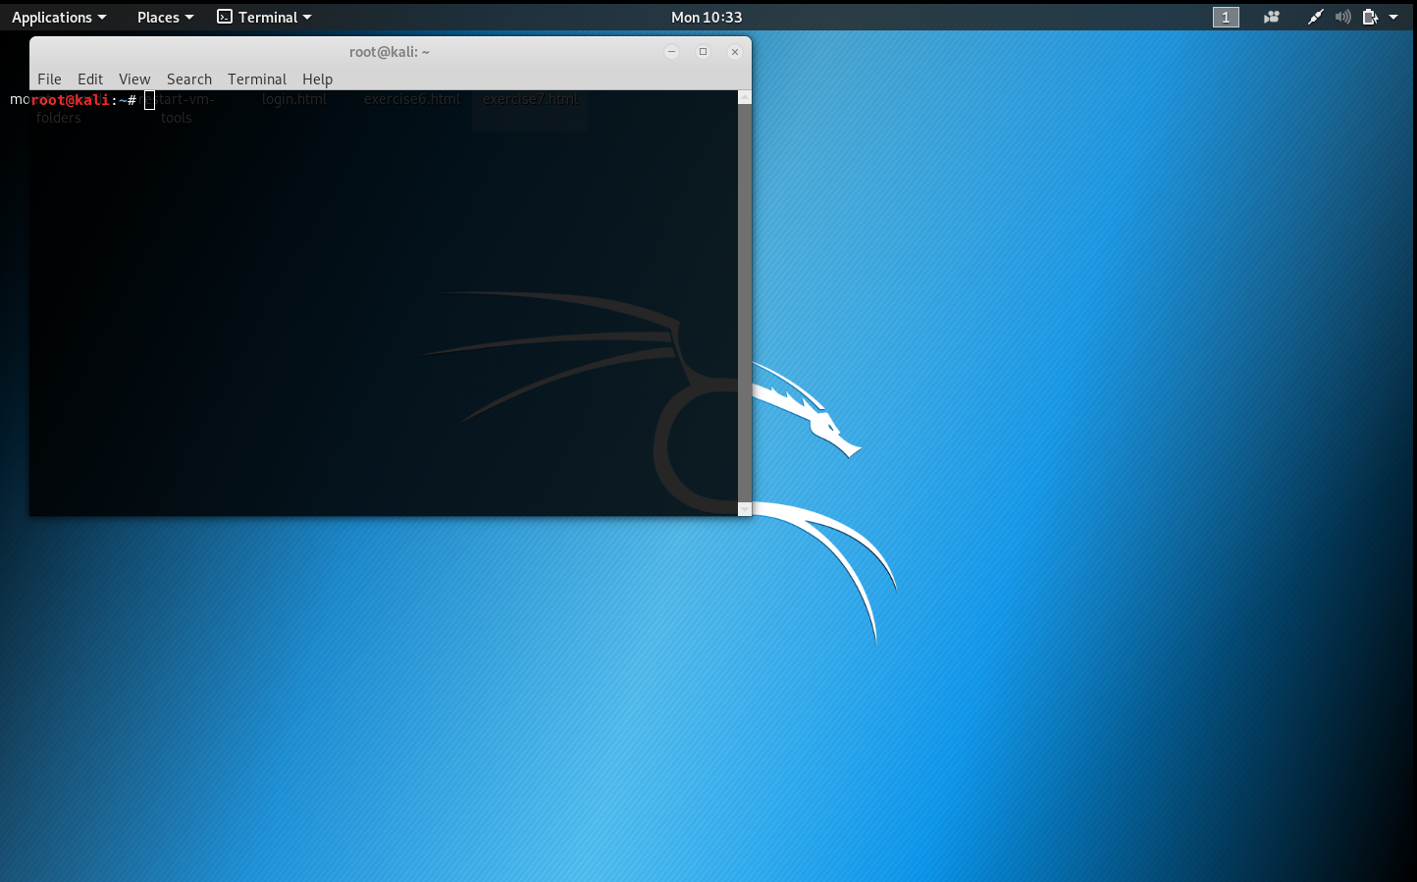
What is Kali Linux?
A Debian-derived Linux distribution designed for digital forensics and penetration testing
Maintained and funded by Offensive Security
More than 600 penetration testing tools
Free and Open-Source

Slide 25
Tool Used
Social Engineering Toolkit, is designed to perform human-side penetration test
SET, in short, is developed by the founder of TrustedSec (https://www.trustedsec.com/social-engineer-toolkit-set/), which is written in Python, and it is open source

Slide 26
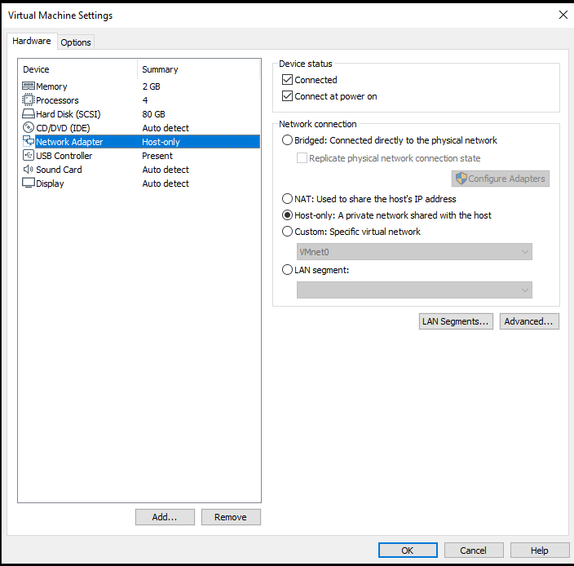
Hands-On Session
Ensure the Network Adapter for your kali Linux is set to Host-Only

Slide 27
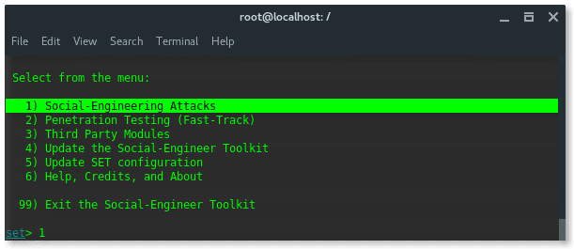
Hands-On Session
Open terminal in kali Linux and enter the following command
Set up the phishing page
echo 1 > /proc/sys/net/ipv4/ip_forward
setoolkit

Slide 28
Hands-On Session
Input (Social-Engineering Attacks)
Input (Website Attack Vectors)
Input (Credential Harvester Attack Method)
Input (Web Templates)
1
2
3
1

Slide 29
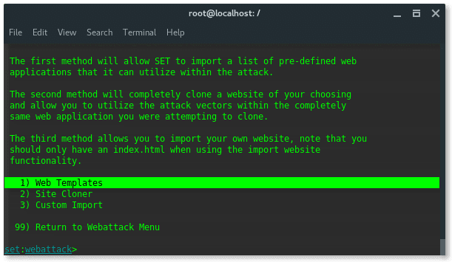
Hands-On Session

Slide 30
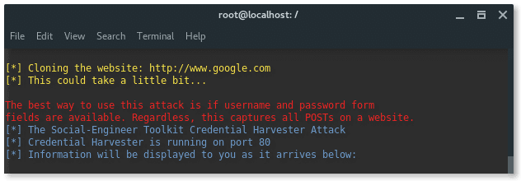
Hands-On Session
<IP addr>
Input of your Kali Linux machine which is assisted by setoolkit, IP within the square brackets
Input to your machine to clone Gmail’s page
Hit Enter when prompted for acknowledgment
2

Slide 31
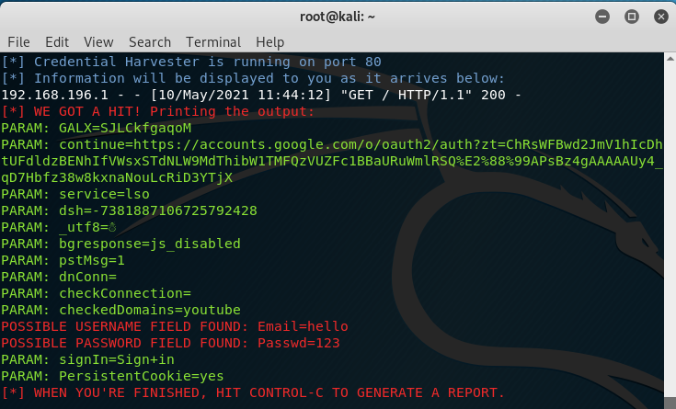
Hands-On Session
At this point, you can navigate to the IP in your browser and see a cloned site of google
Try entering some dummy/fake account detail and see it being captured by setoolkit in the background

Slide 32
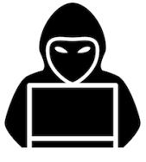

Hackers and Attackers
Hackers
Individuals who have the knowledge and skills to gain access into the computer systems and related entities through unauthorized means
Attackers
Hackers with malicious intents

Slide 33


Types of Hacker
White Hat
  Discovers and exposes security flaws so that the originator can fix before they become widespread problems
  Security Professional/Ethical Hacker
Black Hat
  Discovers and exposes security vulnerabilities for monetary gains and/or for malicious purpose

Slide 34









Categories of Attacker
  Cyber Terrorist/Cyber Army:
  Nation before self
  Cause disruption and chaos
  Electronic Vandal:
  Causes damage and disruption
  For fun, gain attention/admiration
  Resentment toward a person /organization
  Data Thief:
  Professional black hats
  Personal/financial gain
  Script Kiddie:
  Novice
  Uses automated attack tools found online
  Gain attention/proving technical abilities
  Malicious Insiders –
  Employees and contractors:
  Get revenge, cause damage or disruption
  Personal satisfaction and/or financial gain
  Hacktivist – Electronic Activist
  Desire to cause social change
  Gain attention
  May cause disruption and damages

Slide 35

Singapore’s Cyber Crime Law
Computer Misuse Act (Chapter 50A)
Prohibits:
  Unauthorized access to computer material
  Access with Intent to commit or facilitate commission of offence
  Unauthorized modification of computer material
  Unauthorized use or interception of computer service
  Unauthorized obstruction of use of computer
  Unauthorized disclosure of access code
  Abetting any of the above
Notes:
\

Slide 36
Singapore’s Cyber Crime Law
Computer Misuse Act (Chapter 50A)
Cover various aspects of Information Security
  Access Control
  Integrity
  Confidentiality
  Availability
  Authentication
Fines up to $100,000 and imprisonment up to 20 years.
Notes:
\

Slide 37
What’s Covered So Far…
Information Security
  What do we protect?
  Goals of Information Security
Intrusions vs Attacks
Hackers & Attackers
Types of Hackers
Categories of Attackers
Singapore’ Cyber Crime Law

Slide 38
Break Time (30mins)
Short Question & Answer session

Slide 39
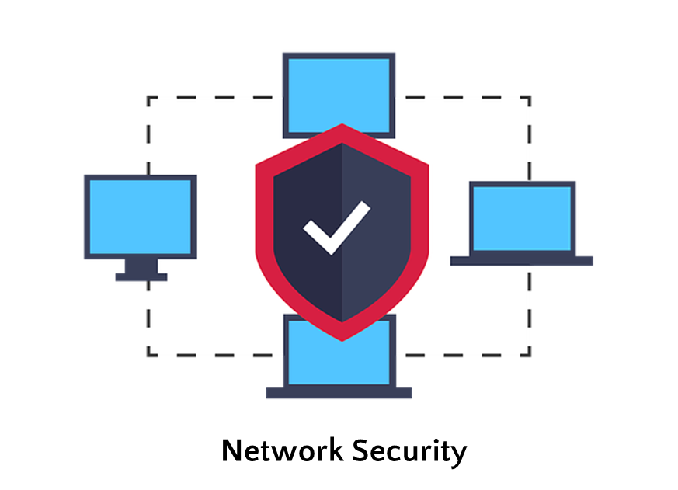
Network Security

Slide 40
Network Security
Encompasses:
  How to design and secure a network and its resources
  How to prevent host device and its resources connected to the network being attack
  How to protect the data being transmitted from one end-point to another end-point from being intercepted and exploited
Covers studies on known threats and preventive measures to these threats

Slide 41
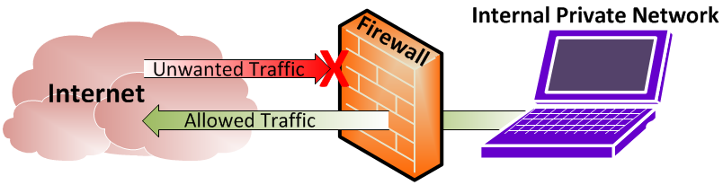
Firewall: Concept
A technological barrier designed to prevent unauthorized or unwanted communications between computer networks or hosts

Slide 42
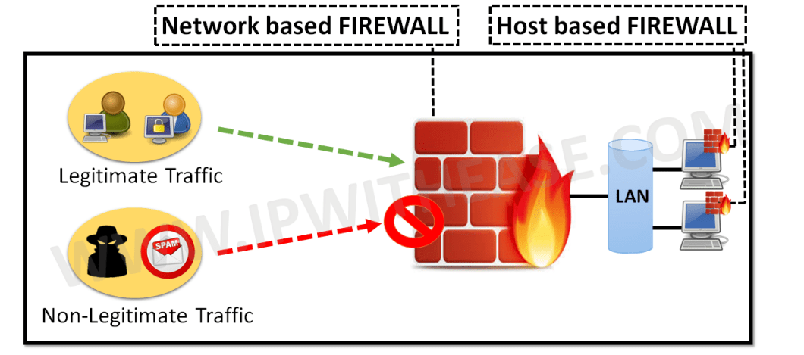
Firewall: Types
Network Firewall: Designed to protect the resources on the network
Host-Based Firewall: Designed to protect the resources in a host-device

Slide 43
Firewall: Techniques
Packet Filtering in Packet Filtering Firewalls
Circuit Level/Stateful Packet Filtering in Stateful Inspection Firewalls
Application-Level Filtering in Proxy Firewalls

Slide 44
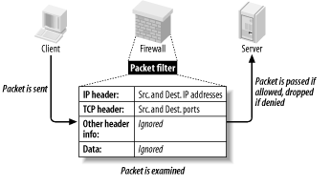
Firewall: Packet Filtering
Each data packet
  Has a unique source and destination stamp in its header
  Depending on its type, it can only either enter or exit the system via a specific port
  All, received or transmitted, are inspected
Data packet accepted or rejected based on a set of pre-defined filtering rules set by the network administrator
Notes:
ToDo: Give a more layman representation in terms of gate security, reorganize IP Addresses and protocol

Slide 45

Firewall: Packet Filtering
In More Relatable Terms
  You’re (a data packet) travelling overseas for a holiday
  Specified in the ticket, you are entitled to a flight from Singapore (source) to the United States (destination)
  Also specified, you are only entitled to leave Singapore from Changi Airport (port) and land only at SeaTac Airport (port) in Seattle, US
  If for some hypothetical reason you have a bad criminal record in the US, when you reach SeaTac Airport, you may be denied entry into the US when determined by the border agents (rules set by network administrators)
* Assuming checks are on done on entry

Slide 46
Firewall: Stateful Packet Filtering
Determine if a data packet belongs to either a new or existing connection
  Allow packets matching a known connection state to get through
  A firewall implementing this technique keeps track of the state of network connections (TCP streams, UDP communication, etc.) traveling across it
  Once all packets have been received/transmitted, the connection is no longer tracked
Example: You have invited some friends (10 people) over for a party at home
  Acting like a firewall, you wait until your 10 friends show up before commencing the party
  In the meanwhile, you prevent everyone else who were not invited from entering your home
Notes:
Idea: Numbering of packets

Slide 47
Application-Level Filtering Technique
Filtering based on the application information within the packet
  Proxies, based on the application’s context, will drop suspicious connections or data
  Clients and servers communicate indirectly via proxies instead of a direct connection
Example: If you’re invited to a ballroom gala event at a hotel with a ‘Formal’ dress code but appear in jeans and slippers (non-compliant non-formal attire), the gala’s reception/registration (acting as a proxy) will prevent you from attending the gala despite having gained access to the hotel’s grounds
Notes:
Todo: Read up more on this

Slide 48
IP Address Spoofing
IP: Internet Protocol
IP Spoofing is the technique of faking the source IP address of a network packet sent from a device
IP addresses are used to identify specific device; using a fake IP address allow hackers to hide or disguise their real identity

Slide 49
Why Spoof IP?
Bypass Authentication based on IP address to access certain resources within a network
  Attacker would want to impersonate a target device within a network of interest
    By assuming that target’s IP address, attacker can conceal his/her identity
    Defeat security measure solely based on IP address Authentication

Slide 50
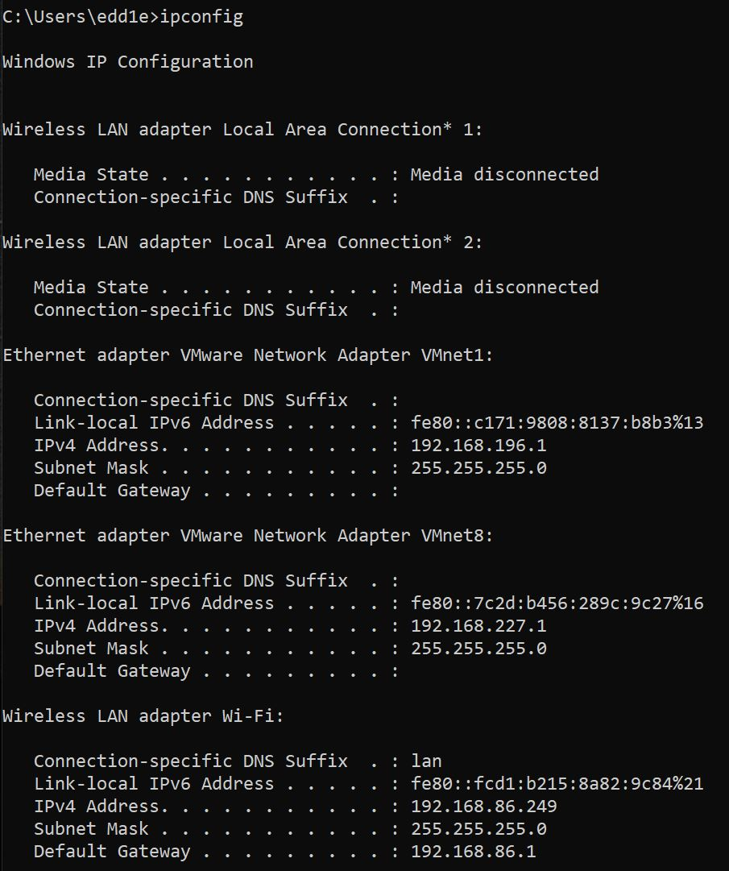
How to know your IP Address?
On Windows Machine open Command Prompt and enter the command ipconfig

Slide 51
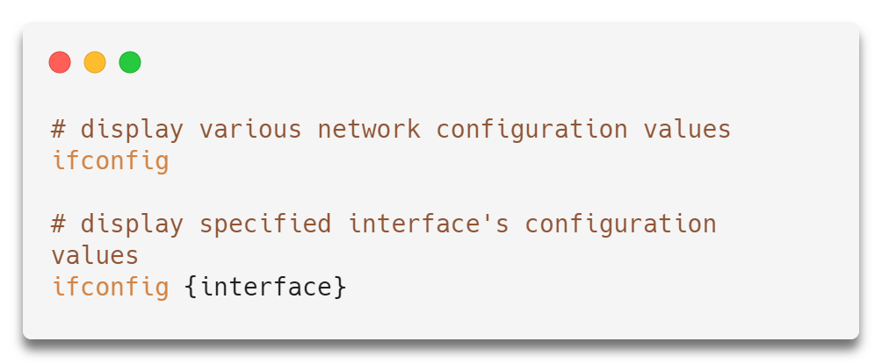
How to know your IP Address?
Open kali Linux terminal, and input the following commands

Slide 52
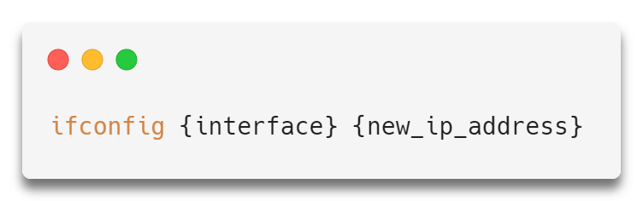
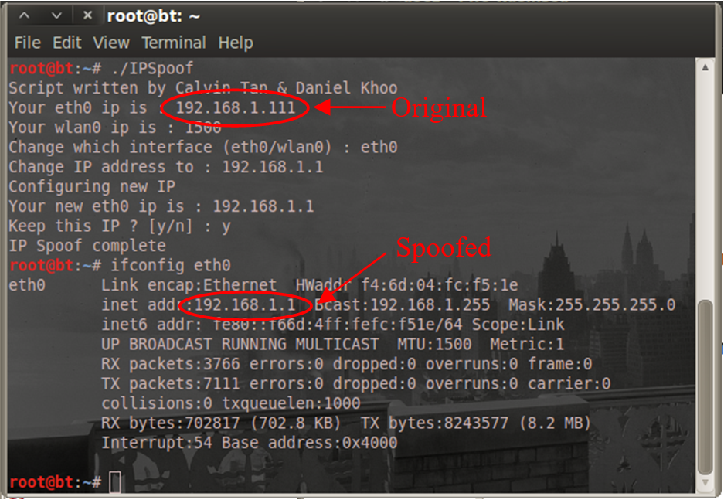
IP Spoofing (Demo)
IP Address (Assigned): 192.168.1.111
IP Address (Spoofed): 192.168.1.1

Slide 53
IP Spoofing Countermeasures
Packet filtering is one of the primary defensive measure against IP spoofing by using ingress filtering, where packets from outside the network with an internal IP address are blocked
Do no solely rely on IP address-based authentication for networking security

Slide 54
MAC Spoofing
MAC: Media Access Control
Technique of changing a factory-assigned MAC address of a network interface on a device with a one specified by the user himself/herself
While the MAC address is hard-coded onto a network interface controller an is unalterable, the spoof masks the OS’s stored MAC address

Slide 55
Why Spoof MAC Address?
Used by attacker to bypass network security protocols that filter user by their MAC address
Allow the attacker to gain access to a network
Similarly, to IP address spoofing, MAC address spoofing can be used to hide the identity of the user either for privacy protection or malicious purposes

Slide 56
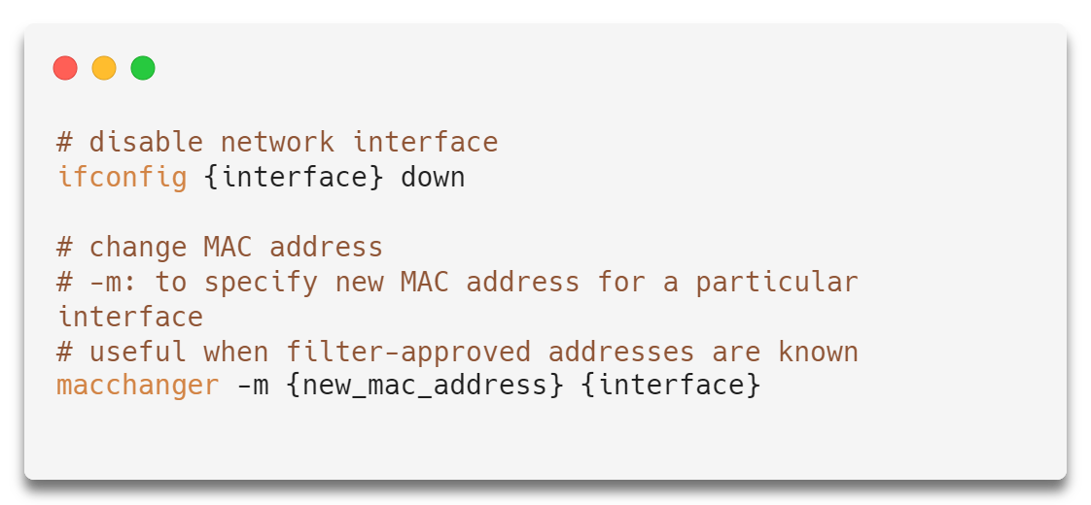
MAC Spoofing (Demo)

Slide 57
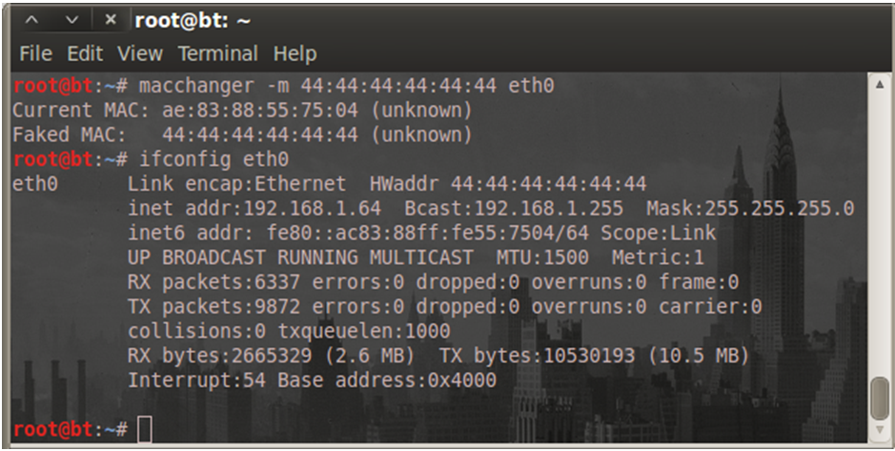
MAC Spoofing (Demo)
Original MAC: ae:83:88:55:75:04 | Spoofed MAC: 44:44:44:44:44:44

Slide 58
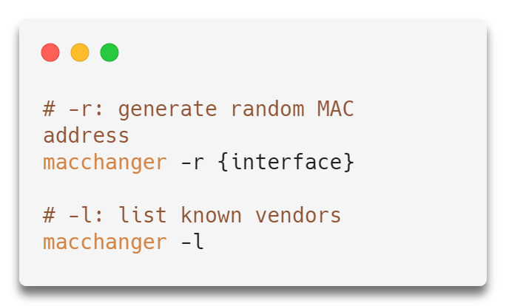
MAC Spoofing (Demo)
Useful
    MAC Address is blacklisted by filter
    Spoof with a more believable MAC address using various vendors’ MAC addresses

Slide 59
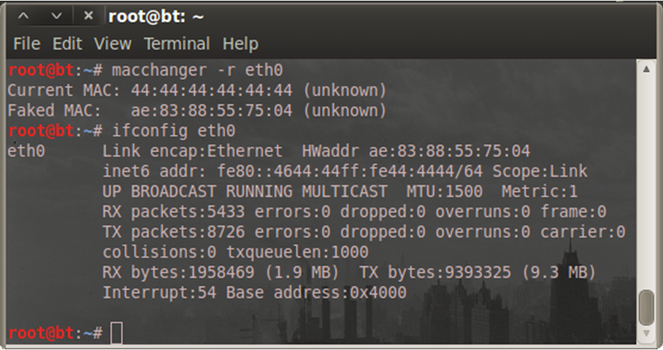
MAC Spoofing (Demo)
Original MAC: 44:44:44:44:44:44 | Randomised MAC: ae:83:88:55:75:04

Slide 60
MAC Spoofing Countermeasures
Since MAC address is typically taken from the OS, easiest way is to check the MAC of the NIC directly
MAC address can be locked to specifically reserve IP addresses requiring both for authentication
Easily bypassed if both MAC and IP addresses are spoofed

Slide 61
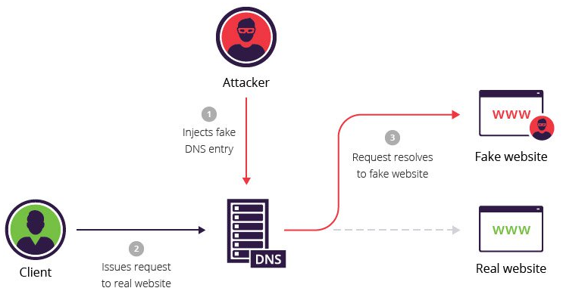
DNS Spoofing
DNS spoofing (or DNS cache poisoning) is a computer hacking attack, whereby data is introduced into a Domain Name System (DNS) name server's cache database, causing the name server to return an incorrect IP address, diverting traffic to another computer

Slide 62
Remember the Phishing Demo?
Put it this way, how do you get the victim to enter your IP address into their browser?
Is there a way to make it more legitimate looking clone of the actual site?
This is where DNS spoofing comes in

Slide 63

DNS Spoofing (Demo)
For this demo we will be using another tool available on kali Linux known as Ettercap
Ettercap is a free and open-source network security tool for man-in-the-middle attacks on LAN

Slide 64
DNS Spoofing (Demo)
Configuring Ettercap
  Open a new terminal in your kali Linux
  Enter the following to enable IP forwarding
  Edit the configurations for Ettercap
echo > 1 /proc/sys/net/ipv4/ip_forward
gedit /etc/ettercap/etter.conf

Slide 65
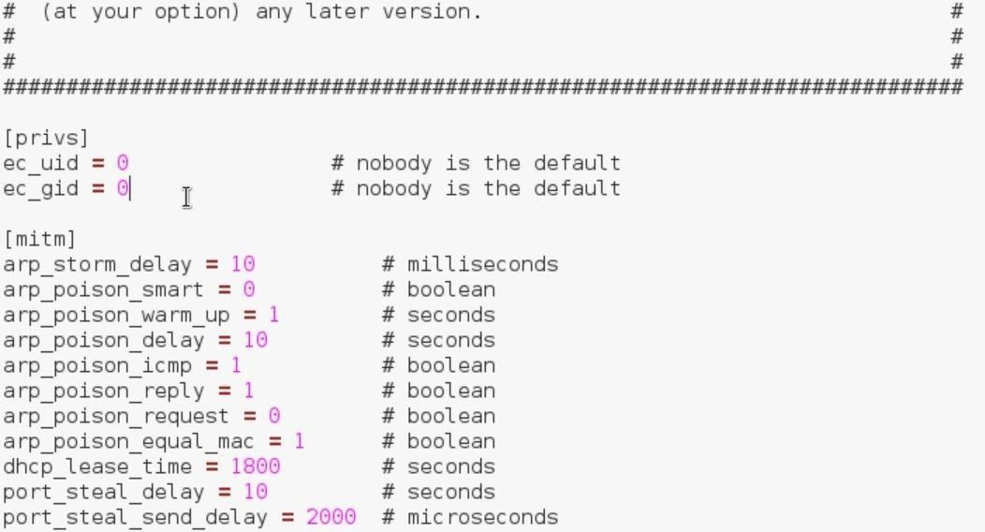
DNS Spoofing (Demo)
Configuring Ettercap
  Set ec_uid and ec_gid to 0

Slide 66
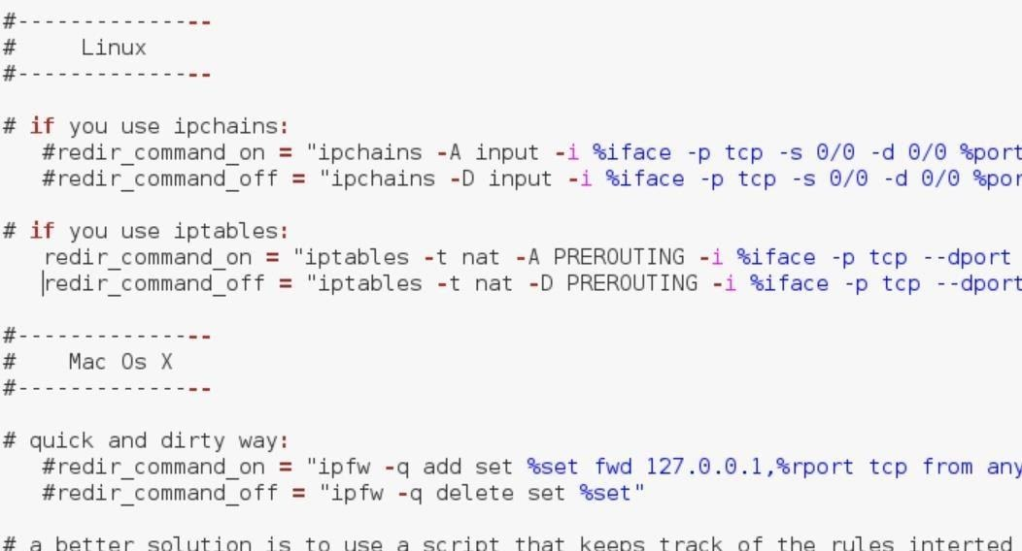
DNS Spoofing (Demo)
Configuring Ettercap
  Scroll down the same configuration file and find # Linux
  Uncomment by removing the # for 2 lines beneath # if you use iptables
  Save and close the editor

Slide 67
DNS Spoofing (Demo)
Configuring Ettercap
  Enter the follow command into the same terminal
    This is to configure the spoofing of the DNS
  Scroll down and find
  Add the following and then save the editor
gedit /etc/ettercap/etter.dns
# mircosoft sucks ;)
g00gle.com A <IP Address of kali machine> *.g00gle.com A <IP Address of kali machine> www.g00gle.com PTR <IP Address of kali machine>

Slide 68
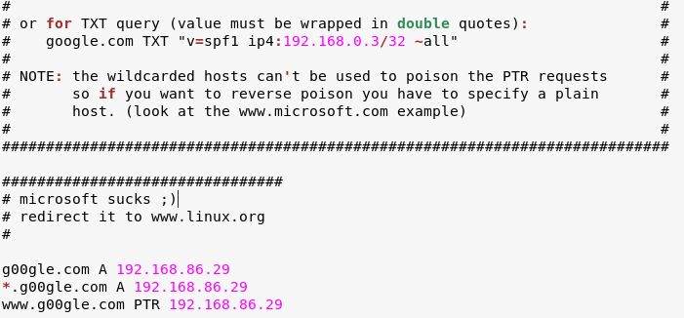
DNS Spoofing (Demo)

Slide 69
DNS Spoofing (Demo)
The etter.dns file is the hosts file and is responsible for redirecting specific DNS requests
Basically, if an unsuspecting victim mistakenly visits g00gle.com, they will visit a website that looks like GMail, even though it’s the malicious website you made (a Gmail clone)
You can sniff sensitive information from any input here onwards

Slide 70
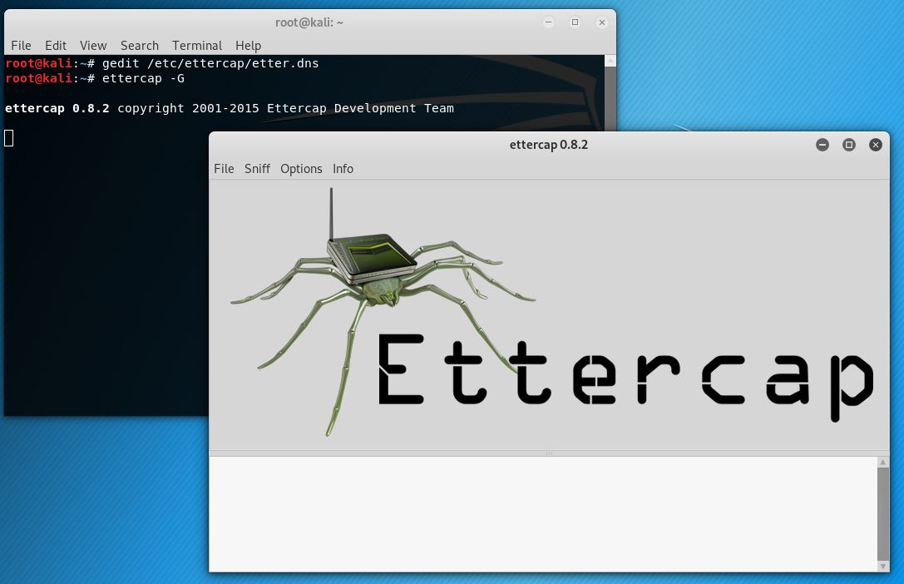
DNS Spoofing (Demo)
Now we run Ettercap by entering the following command into the terminal
ettercap -G

Slide 71
DNS Spoofing (Demo)
In the menu bar, select
  Sniff > Unified sniffing …
  (Select the interface connected to the internet) > OK
In the menu bar, select Start > Stop sniffing
  Ettercap automatically sniffs, but this is not what we want at this stage
In the menu bar, select Hosts > Scan for hosts
  Wait until it completes scanning

Slide 72
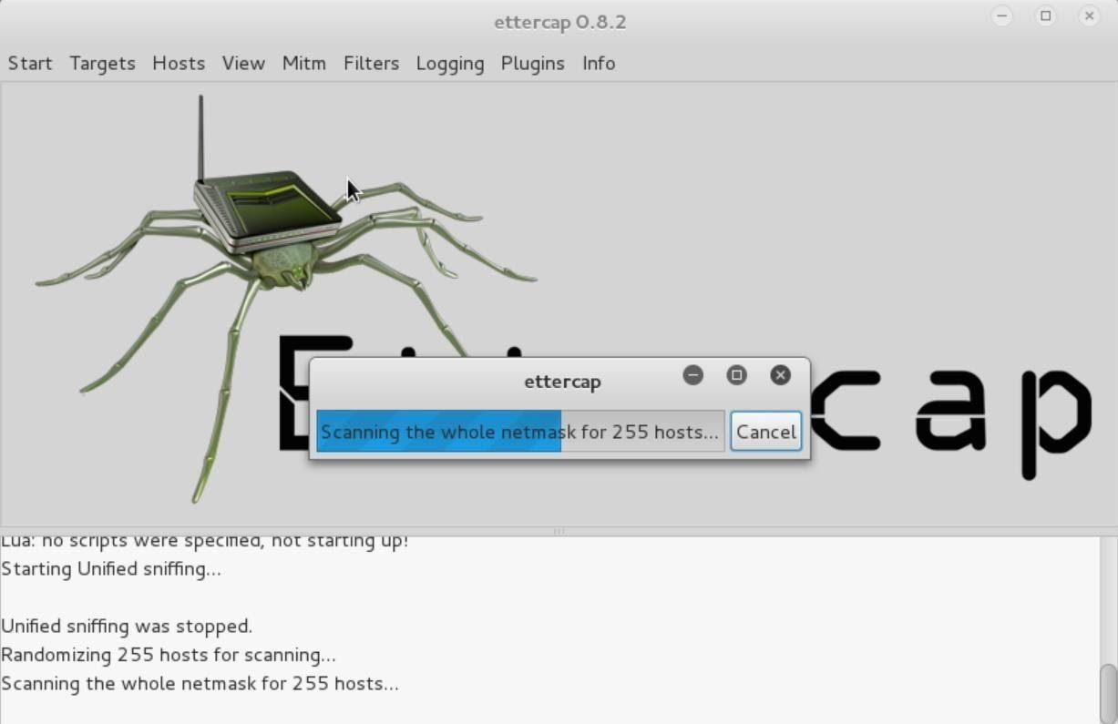
DNS Spoofing (Demo)

Slide 73
DNS Spoofing (Demo)
In the menu bar, select Hosts > Host list
  Displays all potential targets Ettercap found
  Ettercap requires at least 2 IP addresses
    Victim’s IP Addresses
    Your Network Gateway
Finding victim’s IP address, in this case it will be your host machine (Windows machine)
  Launch a cmd and enter the following command “ipconfig”
Select the victim’s IP address within Ettercap and Add to Target 2

Slide 74
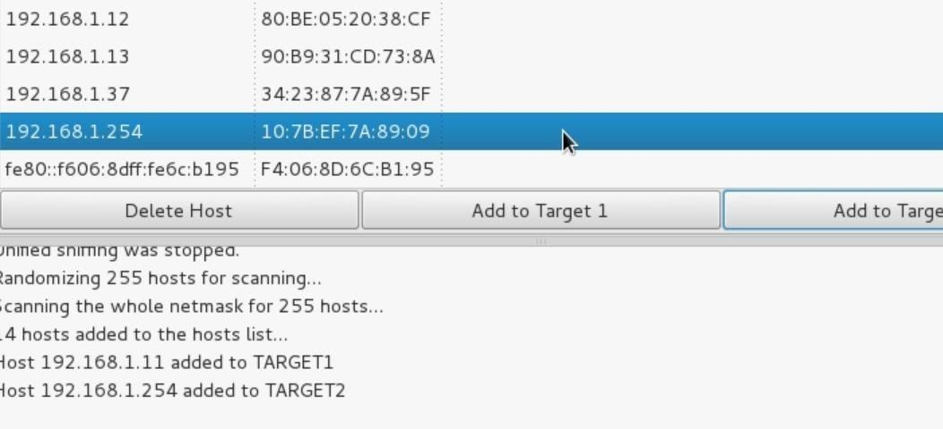
DNS Spoofing (Demo)
Finding Network Gateway IP address
  Can be found from the same ipconfig command
In Ettercap, select the Network Gateway IP address and Add to Target 1

Slide 75
DNS Spoofing (Demo)
In the menu bar, select MITM > ARP poisoning
Click Sniff remote connections > select OK
In menu bar, select Plugins > Manage the Plugins
Double-click dns_spoof
  Asterisk (*) should appear in the first column, denoting that the plugin is active

Slide 76
DNS Spoofing (Demo)
Now repeat the steps you did previously to clone the website from the first hands-on session using setoolkit
Once you see the following prompt as shown below, within Ettercap, in the menu bar, select Start > Start sniffing

Slide 77
DNS Spoofing (Demo)
Every time the victim visits the webpage you indicated in the etter.dns file (in this case, g00gle.com), they will be redirected to the cloned site
This is extremely malicious, since the attacker could write a script that fetches the requested page immediately and sets up the etter.dns file and listens in on the login, all automatically
It’s worrying that it’s really that simple to perform a DNS Spoofing attack with very few resources

Slide 78
What’s Covered So Far…
What is Network Security?
Concept of Firewall
Types of Firewall
Techniques led by Firewall
  Packet Filtering
  Stateful Packet Filtering
  Application-Level Filtering
Spoofing Techniques

Slide 79
Network Security
SSL

Slide 80
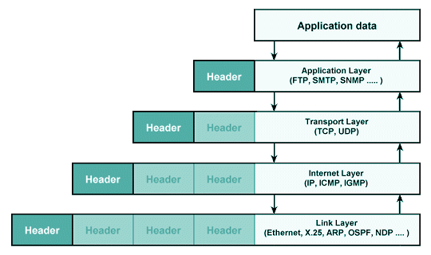
TCP/IP & HTTP
TCP/IP: Transmission Control Protocol / Internet Protocol
  Standard manner by which data is transferred over the Internet
HTTP: Hyper Text Transfer Protocol
  How a webpage is transferred, typically in plain text
Lacks native/in-built encryption
  Data transmission can be sniffed and read by anyone
  Not ideal when transmitting sensitive data such as identification and credit card numbers

Slide 81
TLS/SSL
TSL/SSL: Transport Layer Security/Secure Sockets Layer
  1995: Netscape introduced SSL 2.0
Prevents
  Eavesdropping
  Tampering
State of SSL over time
  1996: SSL 3.0, complete redesign on SSL 2.0
  1999: TLS 1.0, not compatible with SSL
  2018: TLS 1.3, improved flexibility, mandates stronger cryptographic hash functions

Slide 82
HTTPS
HTTPS: HTTP Secure
Website data encrypted either with SSL or TLS (current)
Both TLS and SSL protocols use 'asymmetric' Public Key Infrastructure (PKI) system
An asymmetric system uses two 'keys' to encrypt communications (public, private)
Anything encrypted with the public key can only be decrypted by the private key and vice-versa

Slide 83
How does HTTPS work?
Upon making a HTTPS connection, website sends its SSL certificate to the browser (you)
  Certificate contains the public key needed to begin the secure session
The browser and website then initiates the SSL handshake
  Involves generation of shared secrets to establish a uniquely secure connection
When a trusted SSL Digital Certificate is used during a HTTPS connection, users will see a padlock icon in the browser address bar
  When an Extended Validation Certificate is installed on a website, the address bar will turn green

Slide 84

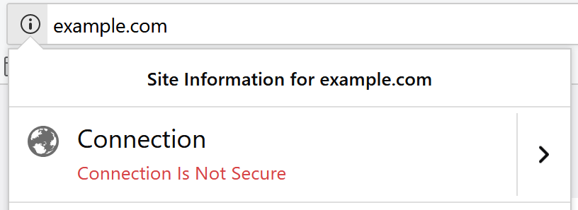
HTTPS Benefits
Communications are encrypted
  Data transferred no longer in plain text, only website and you are aware of the contents
  Protects highly confidential online transactions (online banking, online shopping, etc.)
  Browsers will display padlock icon in the address bar to indicate the connection is either fully or partially secured
  Users trust secured website connections more than unsecured ones

Slide 85
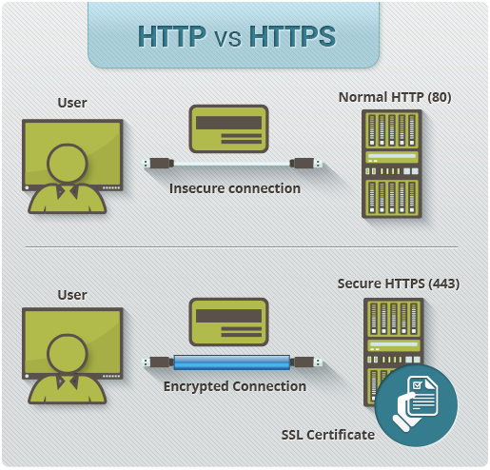

Slide 86
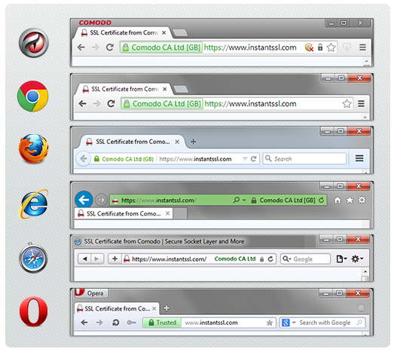
HTTPS Certificate

Slide 87
HTTPS is a countermeasure for DNS Spoofing
Attacks of this kind can be easily foiled by encryption
  Most popular websites and browsers use TLS/SSL to secure web traffic by default (HTTPS vs HTTP)
  Instead of redirecting to the hacker's IP, user will be presented with an error screen
However, this countermeasure leads to complications as the hacker can use it in Denial-of-Service (DoS) attacks.
  Users of the entire network can easily be blocked from a list of popular sites
  For example, by DNS spoofing google.com, users in the network would be unable to access to google search engine

Slide 88
What’s Covered So Far…
TCP/IP & HTTP
HTTPS
HTTPS Process
HTTPS Benefits

Slide 89
Network Security
VPN

Slide 90
VPN
Provides a secure tunnel-like communication when traversing the Internet or, more generally, a network
Communication between endpoints are encrypted
End-points are either host-device or network point (server, etc)
Involves the following:
  Special software and hardware (requester: client, listener: server)
  (often) Authentication required between client and server
End-points appear in the same subnet

Slide 91
VPN
Possible Configurations
  Host to Host (1 to 1)
  Host-to-Network (1 to Many)
  Network-to-Network (Many to Many)

Slide 92
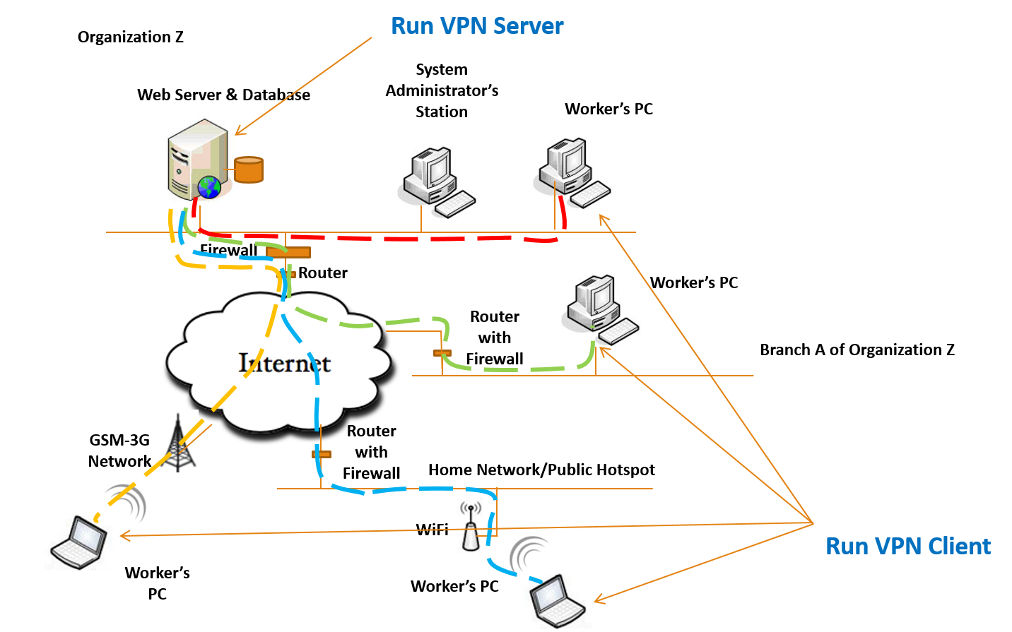
Host to Host

Slide 93
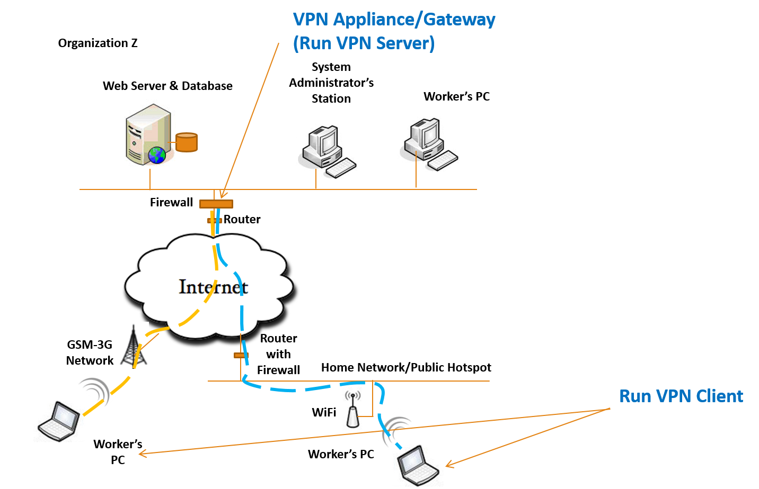
Host to Network

Slide 94


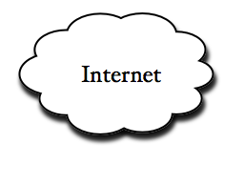
Network to Network
VPN Appliance/Gateway
Organization Z
System
Administrator’s
Station
Web Server & Database
Worker’s PC
VPN Appliance/Gateway
Firewall
Router
Worker’s PC
Router with Firewall
Branch A of Organization Z

Slide 95
Benefits of VPN
  Cost-Saving
    Enables companies to make use of the low-cost Internet, vs pricey leased line
  Flexible
    Can be configured to meet needs and settings for secured communication
  Scalable
    Extend company’s network to their separate branches and connect as though under one single network
  Can implement Extranet (allow partners/clients access to part of company’s network)

Slide 96
What’s Covered So Far…
VPN
  Host to Host, Host to Network, Network to Network
Benefits of VPN

Slide 97

Wireless Security

Slide 98
Wireless (WLAN) Security
WLAN: Wireless Local Area Network
++ Users able to roam freely
-- Unauthorised user receive RF signals: eavesdropping (via wireless sniffer)
Security involves two areas:
  Authentication: Authenticating wireless clients
  Encryption: keeping transmissions private (data privacy)

Slide 99


Wi-Fi
Wi-Fi or WiFi: Wireless Fidelity
Family of radio technologies commonly used for WLAN of devices
Based on the Institute of Electrical and Electronics Engineers’ (IEEE) 802.11 family of standards
Trademark of the Wi-Fi Alliance, a non-profit organisation that promotes the technology and certify products that conforms to certain standards of interoperability

Slide 100

WEP
WEP: Wired Equivalent Privacy
  Original encryption method in 802.11 protocol
  Known to have weaknesses and can be easily cracked
2001: Exploit published by cryptographers
2003: Superseded by WPA

Slide 101
WPA
WPA: Wireless Protected Access
Security protocols to secure wireless computer networks
  WPA: Introduced TKIP (Temporal Key Integrity Protocol)
  WPA2: Mandated AES (Advanced Encryption Standard)-based encryption mode
  WPA3: Encrypts each individual device connection to an unsecured access point
Notes:
TKIP: Generate unique encryption keys for each data packet
AES: Better encryption algorithm

Slide 102
WLAN Authentication
AP: Access Point
  Wireless clients must be authenticated before being associated with an AP
  Authentication is the process which wireless client has its identity verified by the AP
Authentication Methods
  Open System Authentication
  Shared Key Authentication
  802.1x

Slide 103


WLAN Security Threats
Threats
  Hardware Theft
  AP Impersonation (Rogue APs, Evil Twin)
  Passive Monitoring
  Denial of Service
  Ad Hoc Network

Slide 104
WLAN Security Threats
  Rogue APs
    Hacker’s AP connected to corporate wired-LAN
    Bears same SSID, users may unknowingly connect to LAN via it
  Ad Hoc Networks
    Peer-to-Peer (P2P) between stations without an AP
    No corporate security in place
    May provide an entry if the laptop is also connected to the wired LAN
Notes:
SSID: The Access Point’s Name (for example: NTUWL, NTUSECURE)

Slide 105
WLAN Security Threats
  Denial of Service
    Jamming the frequency where the WLAN is located to cause an interruption of service
    Flooding wireless network with probe requests or association frames, making network occupied for normal transmission
  Passive Attacks
    Gather information to be used in an active attack that a hacker is planning to execute later
    Wireless sniffing is often used
    Hacker captures large amounts of raw frames to analyze to discover a key for decryption

Slide 106
WLAN Conventional Security Measures
  Setting SSID beacon/broadcast to “off” (hidden network)
  Access control list with MAC or IP addresses of approved clients
  Reduction of transmission power in APs used in WLANs - decreases distance radio waves travel, limit range hackers can pick up signal
  Utilise WPA, rather than WEP
  128-bit WEP keys rather than 40-bit keys
  WPA authentication with TKIP/AES encryption

Slide 107
What’s Covered So Far…
Wireless (WLAN) Security
Wi-Fi
WEP
WPA
WLAN Authentication
WLAN Security Threats
WLAN Conventional Security Measures

Slide 108
END
!!! THANK YOU !!!
http://www3.ntu.edu.sg/scse/wks.html

